Slide 1
Introduction
At the end of January 2026, we were invited to visit Inta Bina’s office to explore a potential partnership with the founders for our construction business. The founders indicated their willingness to let go up to 20% equity, with the possibility of enlarging the capital base by issuing new shares, to make OSK the single largest shareholder of Inta Bina. This could be via other means, such as a share-swap arrangement with our construction arm.
Currently, our Group has a construction platform primarily supporting its in-house property developments. Moving forward, it intends to progressively strengthen its construction capabilities by reducing reliance on external parties/contractors and securing external construction projects. This investment opportunity with Inta Bina provides a different trajectory by partnering with an established listed construction company that serves external clients.
We set out below and in the ensuing pages our assessment of this opportunity.
1.0
2.0
3.0
4.0
Is Inta Bina a meaningful Target?
Acquisition – Immediate Benefits & Consideration
Strategic Fit & Proposed Transaction Structure
Recommendation & Long Term Consideration

Slide 2
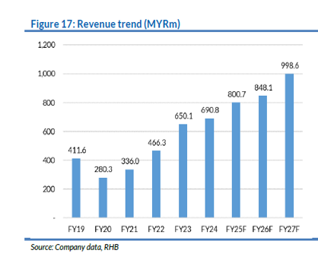
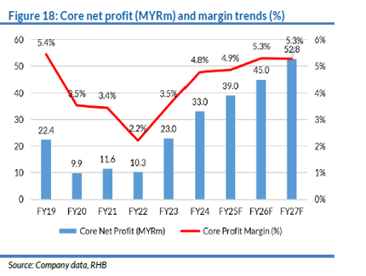
Is Inta Bina a meaningful Target?
Inta Bina – A meaningful and viable acquisition target in the Malaysian construction sector space as the Group has demonstrated solid operational track record, diversified project pipeline, healthy cash/low leverage balance with a strong orderbook and positive growth outlook. (refer Part 1 of Appendix of this report for more detailed information on Inta)
About Inta Bina Group Berhad – | Established: 1987; Management buyout: 2000; Listed on ACE Market in 2017, then Main Market in 2018. Business: G7 building contractor with 30+ years’ experience, primarily in Klang Valley and Johor. Focuses on high-rise residential, commercial, industrial, and leisure construction. Track Record: Completed 155+ projects with total contract value c. RM5 billion. Clients: Long-standing relationships with major developers, including UEM Sunrise, Gamuda Land, Mah Sing, Mitraland, EcoWorld, Tropicana, among others.
Financial Highlights | Revenue & Profit Growth: Revenue has shown consistent growth ( c.RM650 m in 2023 to c.RM690 m in 2024) with improving profit levels supported by better margins and a growing project pipeline. Orderbook Strength: As of mid-September 2025, the unbilled order book stood at RM1.8 billion, providing earnings visibility for the next 2 to 2.5 years Tender Pipeline: The company has a robust outstanding tender book of RM4.5 billion, with a historical success rate of 15% to 20%.

Slide 3
Is Inta Bina a meaningful Target?
Financial Highlights (cont’) | Cash flow & Gearing & P/B Ratio: The recent private placement has strengthened Inta Bina’s balance sheet, with a healthy cash (peaking at RM140.6 mil), low gearing <1x and a healthy P/B in the range of 1.1–1.4x, reflecting strong liquidity, manageable leverage and fair valuation. PPE: The Group’s fixed assets are heavily weighted towards plant and machinery, which comprise 72% of the PPE balance indicating that the bulk of the capex is focused on core assets rather than administrative or non-operational assets.
Benchmark & Valuation Context ^{N1} research report dated 30 October 2025 | Broker coverage (RHB) has often assigned “Buy” ratings^{N1} with upside targets, based on solid orderbook and earnings growth prospects, though valuation multiples remain modest relative to larger peers. Compelling value proposition relative to its peers, trading at a P/E of 6.91x, P/B of 1.09x, and EV/EBITDA of 4.61x, supported by a healthy cash position (more than RM100mil) and gearing below 1x, reflecting a solid balance sheet. With a market cap of RM267.4 mil and 30+ years of operational track record, it offers growth potential and stability, making it a worthy consideration as an acquisition target—particularly for companies seeking a mid-sized construction firm with room to scale and to unlock operational and cost synergies across both organisations.
 | Inta | Kitacon | MGB | Binastra | Kerjaya
P/E | 6.91 | 6.87 | 5.03 | 20.95 | 16.99
P/B | 1.09 | 0.99 | 0.41 | 7.86 | 2.90
EV/EBITDA | 4.61 | 1.87 | 2.70 | 13.77 | 10.57
Market Cap (RM’ mil) | 267.4 | 362.7 | 254.4 | 2,433.7 | 3,434.5
Shares (mil) | 614.63 | 500.34 | 591.65 | 1,091.35 | 1,267.21
Note : Given that OSK Group trades at a higher P/E multiple (9.27x) relative to Inta Bina, the transaction presents potential valuation accretion for OSK
Information as at 21st Jan 2026

Slide 4


Acquisition – Immediate Benefits & Consideration
OSK’s property development arm is currently supported primarily by its in-house construction arm. OSKC which has historically played a project management office role by engaging, coordinating and overseeing external contractors for the construction works.
Moving forward, the Group intends to progressively strengthen its construction capabilities by reducing reliance on external parties, taking on a larger scope of works in-house for its own property developments, while concurrently exploring opportunities to bid for construction projects from external third-party clients.
In line with this strategic direction, the Group is exploring a potential “merger” with Inta Bina, a listed construction company with an established presence in the construction market.
Reasons supporting the Proposed Acquisition / Merger
Revenue Diversification &
De-risking
Immediate Market Access &
Track Record
Margin & Cost Synergies
Capital Efficiency
Earning & Valuation-accretive
Matters for
Consideration
Client Conflict & Perception Risk
Margin Dilution &
Earnings Quality
Balance Sheet &
Risk Profile Shift
Execution & People Risk

Slide 5
Acquisition – Immediate Benefits
- Reasons supporting the Proposed Acquisition / Merger
Revenue Diversification & De-risking Reduces cyclicality of in-house development: Construction revenue from third-party developers smooths earnings when your own launches slow. Counter-cyclical benefits: External construction jobs may continue even when your landbank monetisation pauses. Broader and New earnings base: Improves investor perception vs a “single-client (self)” construction model and venture into new business i.e. recurring income from facility management project such as Lifts and Escalator maintenance services
Immediate Market Access & Track Record Acquiring a contractor with: Pre-qualified status with tier-1 developers Live order book and proven delivery Avoids the long gestation period of organically building credibility with external developers.
Margin & Cost Synergies Internal margin capture: Allows the Group to capture the additional margin instead of paying it to a third party Better cost transparency on build costs. Procurement leverage: Scale in materials, subcontractors, preliminaries. Standardisation: Construction methodologies, specs, value engineering rolled out across group.
Capital Efficiency Construction arm can: Improve group cash flow profile (progress billings vs lumpy development profits).

Slide 6
Acquisition – Consideration
- Matters for Consideration
A. Client Conflict & Perception Risk
Third-party developers may:
Information leakage (pricing, margins, land strategy).
Fear capacity prioritisation for your own projects.
Risk of:
Order book attrition post-acquisition.
“Soft” exclusion from tenders.
B. Margin Dilution & Earnings Quality
External construction margins are often:
Low single digit
Exposed to cost overruns, LADs, subcontractor failures.
C. Balance Sheet & Risk Profile Shift
Construction brings:
Higher working capital intensity
Performance Bond, guarantees, retention sums etc.
Investors may see:
Higher risk vs pure development model.
Greater earnings volatility quarter-to-quarter.
D. Execution & People Risk
Construction success is people-driven:
Project directors
Commercial managers
Site teams
Key risks:
Talent flight post-deal
Cultural clash Loss of entrepreneurial drive if over-integrated

Slide 7
Strategic Alignment with OSK Group
In assessing the strategic alignment, there are 2 aspects that we consider:
Whether having Inta Bina Group under the umbrella of OSK Group, thereby becoming sister-company of OSK Property, would affect Inta Bina’s long-term ability to win residential projects from third party property developers.
Both OSK Construction and Inta Bina are involved in the same business, i.e. construction of residential buildings. There should not be 2 entities within the OSK Group which are competing in nature, therefore proposed merger of these 2 construction entities should be on the card if OSK Group wishes to explore the opportunity of investing in Inta Bina.
For item a above, we looked into Main-Market listing companies which are involved in both Property Development and Construction business within the Group to determine whether there’s any synergy or rather constraints of having both businesses within the Group.
For the purpose of this assessment, we have selected six (6) selected companies, namely, Sunway, Gamuda, IJM Corporation, Malton, LBS Bina and MGB. We observed that while certain listed groups exhibit scale across both property development (“PD”) and construction verticals, the external construction earnings are predominantly derived from non-residential or infrastructure-related projects, rather than third-party residential developments. This suggest a structural separation that limits the extent of synergies between PD and residential-focused construction within the same group.
A detailed breakdown of the companies and key observations is set out in Appendix 1.

Slide 8
Proposed Transaction Structure
Shareholding Structure (As-Is)
Step 1 - Merger (Inta Bina acquire OSK Construction via share swap)
Step 2 - PJDH to acquire Inta Bina stake from existing major shareholders
Inta Bina Group
Inta Bina
Group
OSKC
PJD
Founders & PACs
Cash
PJD
Founders
& PACs
Others
issuance of shares in Inta
Equity
stake in Inta
58%
42%
Founders
& PACs
PJD
Others
Founders
& PACs
PJD
Others
Inta Bina
Group (“Inta”)
47.23%
18.56%
34.21%
34.73%
31.06%
34.21%
OSK Group
Inta
Inta
PJD
100%
OSKC
OSKC
OSK Construction (“OSKC”)

Slide 9
Recommendation & Long-Term Consideration
Our view : For a longer-term strategic alignment and direction perspective, OSK may be better off keeping OSK Construction as an in-house residential contractor, and at the same time, focus on developing industrial & commercial capabilities & track record (either organically or via M&A way).
Today
(Immediate Upside)
Tomorrow
(Long Term Focus)
Enhanced operational efficiency and margin capture – Integrates the acquired group’s projects into existing operations, reducing reliance on third-party contractors and retaining full project margins.
Economies of scale – Shared resources (equipment, workforce, procurement) reduce unit costs and improve efficiency.
Earnings accretion potential – Given that OSK Group trades at a higher P/E multiple (9.27x) relative to Inta Bina, the transaction presents potential earnings uplift through valuation arbitrage.
From a longer-term and strategic perspective, there is an increasing risk for the enlarged Inta Bina group in securing external residential projects from third-party developers.
This risk arises because Inta Bina will be associated with OSK Group, which has a significant presence in property development.
We observed that construction arms of property developers focus on serving in-house residential projects. External orderbooks are usually built in industrial, infrastructure, and commercial segments rather than residential (refer Appendix 1)
Point to Note : To determine the potential erosion to OSK Property (PropDev) margin once the construction work is no longer done by “in house” group

Slide 10






Recommendation & Long-Term Consideration
Strategic Consideration Moving Forward
In our view, integrating Inta Bina may limit external residential wins due to OSK’s property developer profile. The optimal strategy is to maintain an in-house residential construction arm while building non-residential capabilities.
Maintain OSK Construction (Residential)
Develop Non-Residential Capabilities (Organic / M&A)
Short-Term
Long-Term
Better M&A Alternatives
Short-Term Upside
Earning accretive for OSK Construction
Non-Residential Focus
OSKC
Inta Bina
Internal Focus Residential
External Focus – Residential Focus
Commercial
Industrial
Infrastructure
Short-Term Margin Risk
Potential Margin Dilution for OSK Property Dev.
Potential Conflict
Lower External Residential Opportunity as associated with OSK Property (PropDev)

Slide 11






Thank You
OSK Holdings Berhad
Level 21, Plaza OSK, Jalan Ampang,
50450 Kuala Lumpur, Malaysia.
(603) 2166 6225
(603) 2026 6331
info@oskgroup.com
www.oskgroup.com
Disclaimer: This material is proprietary and is prepared specifically for the recipient’s reference. The information contained herein is not to be distributed without the consent of OSK Holdings Berhad. Any recommendation or views contained in this document do not have regard to specific investment objectives, financial situation and the particular needs of any specific audience. The content furthermore is believed to be correct at the time of the issue of this document, and is not and should not be construed as an offer or a solicitation of any offer to buy or sell any securities. Nor does this document purport to contain all the information a prospective investor may require.

Slide 12
Appendix 1 : Industry Peers
01

Slide 13
Appendix 1.0: The six (6) selected companies, which report both Property Development and Construction segments in their Annual Reports
Bursa Classification: Construction
Bursa Classification: Construction
Bursa Classification: Construction
Bursa Classification: Property
Bursa Classification: Property
Bursa Classification: Construction
Note: MGB Construction’s contribution is included under LBS Bina Group’s construction segment.

Slide 14
Appendix 1.1: A company can be large in both property development and construction, with construction focused on external and non-residential works.
RM’mil
RM’mil
RM’mil
These companies have sustained both PD and construction segments, with construction mainly focused on external work.
Notes:
External Residential work creates a conflict of interest, unlike Infrastructure & Industrial work

Slide 15
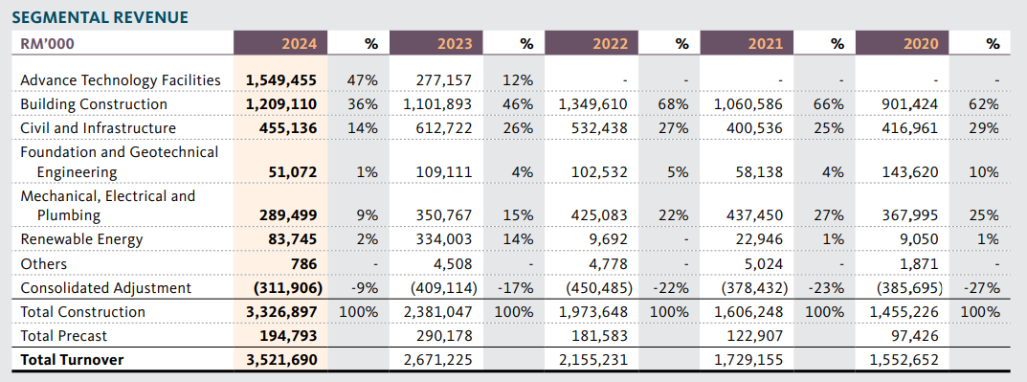
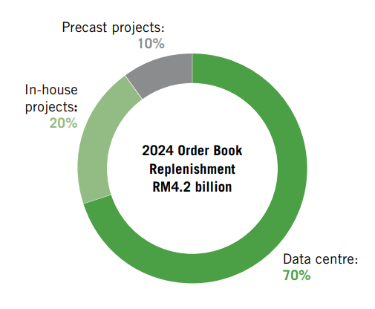
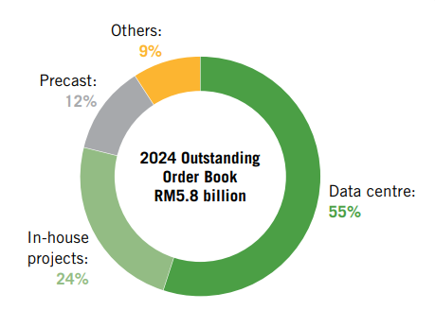
Appendix 1.1a: Sunway Group holds a 54.55% equity stake in Sunway Construction Group Berhad. SunCon primarily focuses on external industrial and mixed-development projects, while residential construction is largely undertaken only for Sunway’s in-house developments.
In house Commercial Projects in FY2024:
Sunway Medical Centre Damansara
Sunway Medical Centre Ipoh
In house mixed development project:
Sunway Square
Daiso Global Distribution Centre (GDC) warehouse
In house residential projects:
Sunway Velocity 2 (Plot B)
Sunway Belfield

Slide 16
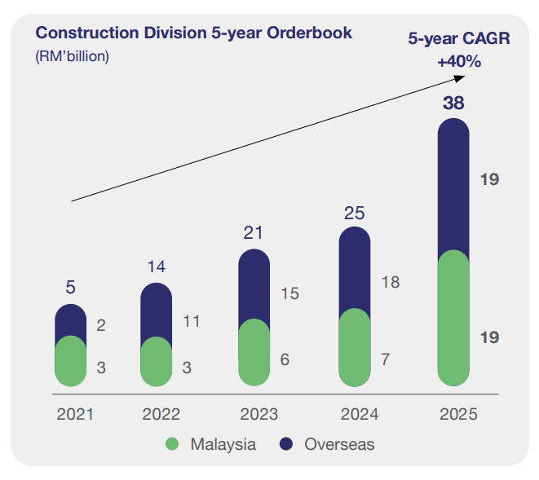
Appendix 1.1b: Gamuda’s order book is driven by non-residential projects, allowing the Group to scale its Construction segment without exposure to the inherent COI risks with PD work.
Gamuda secured a total of RM25 billion in new order for FY2025, comprising projects across the Renewable Energy (RM6.3 billion), Transport and Infra (RM15.0 billion), and Data Centre (RM3.6 billion).

Slide 17
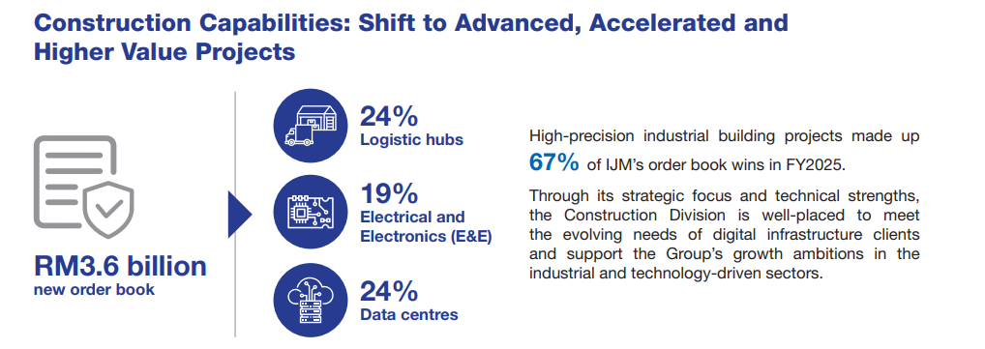
Appendix 1.1c: IJM Corp Secured RM3.6 billion new order book, 67% from industrial segments, including 3 major data centre projects worth RM845.20 million in FY2025

Slide 18
Appendix 1.1d: LBS holds a 57.83% equity stake in MGB Berhad. MGB predominantly undertakes internal construction works for the LBS Group, with its external revenue broadly equivalent to LBS’s total construction revenue.
MGB complement by lowering LBS's cost of building affordable homes, with margin mainly comes from IBS efficiency.
Collaborate with Permodalan Negeri Selangor Berhad to provide affordable housing
IBS panels led a 33% reduction in construction time and a 31% decrease in reliance on manual labour

Slide 19
Appendix 2 : About Binastra & Nestcon
02

Slide 20
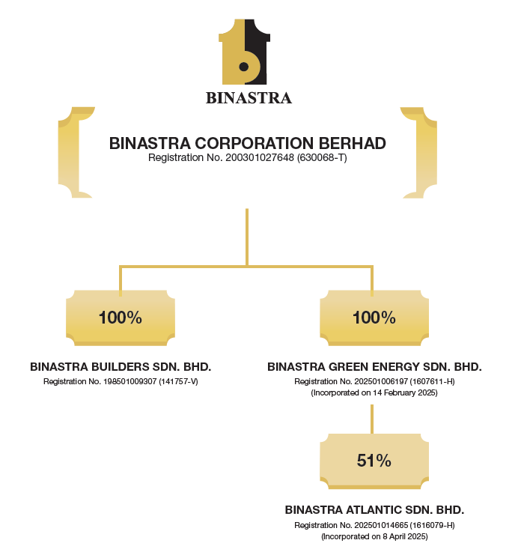
Binastra Corporation Berhad (Incorp: 2003 HQ in KL), formerly known as Comintel Corporation Bhd, is involved in general contracting and property development, specialising in building and civil engineering turnkey projects across residential, commercial, and industrial segments in Malaysia. In FY2025, its subsidiary Binastra Builders Sdn Bhd (BBSB) expanded its principal activities to include property development, building and civil engineering works (turnkey and design‑and‑build), and EPCC services.
Market Cap | 2,346.39
Enterprise Value/EBITDA | 13.84
Trailing P/E | 16.54
Forward P/E | 13.52
Price/Book | 7.71
RM’Mil
 | Length of relationship
Customers | years
Platinium Victory Sdn Bhd | 20
EXSIM Development Sdn Bhd | 13
Maxim Global Berhad | 6
Source: Mercury Securities
-224%
Business Segment | Revenue (RM) | Revenue (%)
Construction | 946,044,000 | 99.9%
Investment Holding | 552,000 | 0.1%
Total | 946,596,000 | 100%
RM’Mil
Top 3 Shareholders
41.21% | 12.93% | 11.09%
JL Conglomerate Sdn Bhd | Lee Yong Seng | Datuk Tan Kak Seng
Source: Mercury Securities

Slide 21
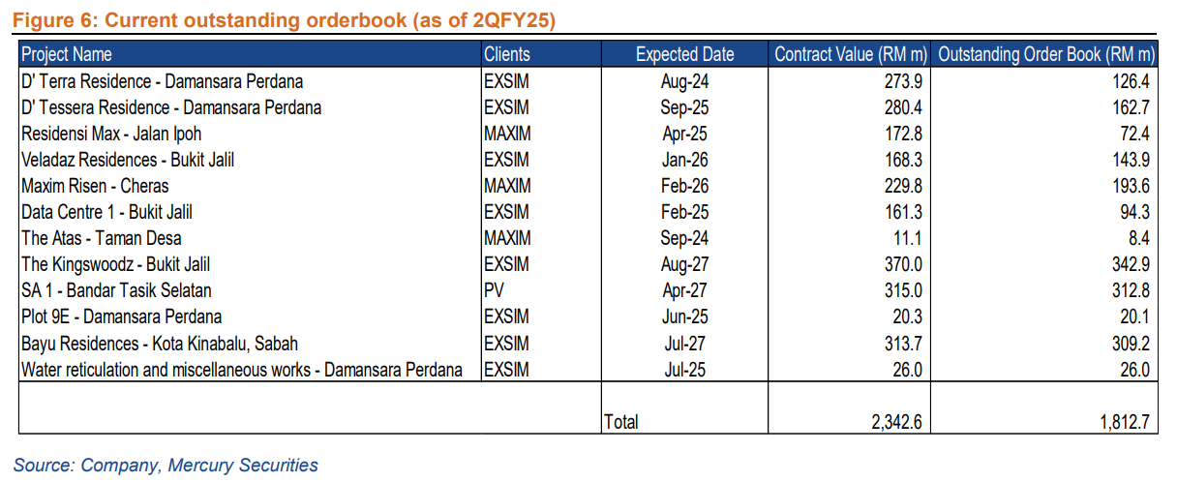
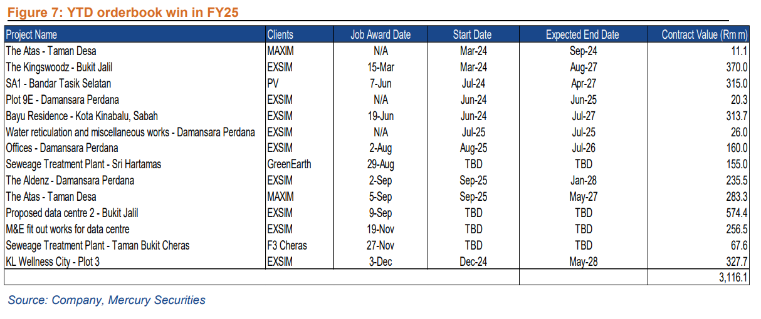
Binastra Ongoing Projects
Project Description | Segment/Type | Contract Value (RM) | Status/Note
High-Capacity Data Centre | Data Centre | 574.4 million | Turnkey project.
Data Centre M&E Works | Data Centre | 256.5 million | Mechanical and electrical fit-out works in Kuala Lumpur.
Residential Development (Kota Kinabalu) | Building Construction | 313.7 million | First project in Sabah (East Malaysia).
Sewage Treatment Plant | Infrastructure | 155.0 million | Design and build of a membrane bioreactor.
Source: AR2025 (FYE of 31 January 2025)

Slide 22
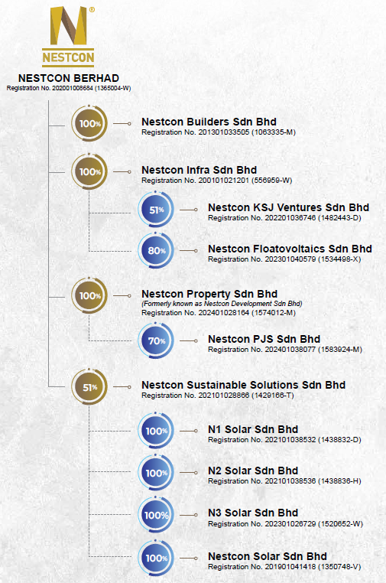
Nestcon Berhad (Incorp: 2001 HQ in Puchong), undertakes civil engineering and infrastructure works including earthworks, land reclamation, roadworks, and railway and bridge construction as well as building construction across residential, commercial, and industrial properties. Its subsidiaries, Nestcon Infra, Nestcon Builders and Nestcon Solar, are registered G7 CIDB contractors. In May 2024, the Group diversified into renewable energy, offering EPCC services for solar PV systems for residential, commercial, and industrial customers.
RM’Mil
Market Cap (Intraday) | 230.64
EV/EBITDA | 8.81
Trailing P/E | 30.50
Forward P/E | N/A
Price/Book | 1.38
Name | Title
Mohd Noor Bin Setapa | Independent Non-Executive Chairman
Datuk Ir. Dr. Lim Jee Gin | Group MD & Director
Lim Joo Seng | Finance Director & Executive Director
Ong Yong Chuan | Executive Director
Nor Azzam Bin Abdul Jalil | Independent Non-Executive Director
Yeoh Sheong Lee | Independent Non-Executive Director
Roslinda Binti Awang | Independent Non Executive Director
RM’Mil
Business Segment | Revenue (RM) | % Contribution
Building Construction | 632,320,000 | 75.4%
Civil Engineering & Infrastructure | 188,540,000 | 22.5%
Renewable Energy | 17,270,000 | 2.1%
Total | 838,130,000 | 100%
Shareholding structure
50.82% | 9.05% | 0.35% | 0.28%
Datuk Ir. Dr. Lim Jee Gin | Ong Yong Chuan | Yeoh Sheong Lee | Lim Joo Seng
Source: AR2024

Slide 23
Nestcon Ongoing Projects
Project Name | Segment | Key Details
Arte Solaris Residence | Building | 52-storey mixed development in Mukim Batu, KL.
Hugoz Suites | Building | 46-storey mixed development (apartments/offices) in KL.
Kuchai Sentral Residence (Phase 2) | Building | 30 and 34-storey serviced apartments in Mukim Petaling, KL.
Wawari Phase 1 Township | Infrastructure | Earthworks and main infrastructure in Johor Bahru.
Nenggiri Hydroelectric Project | Infrastructure | Civil and associated works in Gua Musang, Kelantan.
Damansara Perdana Works | Infrastructure | Rock blasting and general works in Selangor.
Selco Solar PV Plant | Renewable Energy | Design and EPCC at Sungai Selangor.
Tanjung Dua Belas Solar Plant | Renewable Energy | 15MWp floating solar plant in Kuala Langat.

Slide 24
Part 1 : About Inta Bina
02

Slide 25
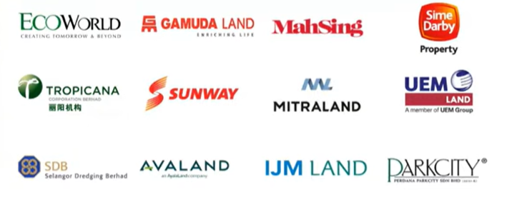
Key Takeaway
About Inta Bina
Incorporated in 1987, the Group underwent a management buyout in 2000, was listed on the ACE Market in 2017, and subsequently transferred to the Main Market in 2018.
Inta Bina is a G7 building construction contractor with more than 30 years of operating history and projects are mainly in the Klang Valley and Johor. Its main focus lies in constructing various type of buildings, encompassing high-rise residential and commercial properties, industrial as well as leisure properties.
Completed over 155 projects with a total contract value of c. RM5bil
Clientele
New client : Post 2024
Shareholding structure
(Source : RHB analyst report : Steadily Building Stronger– 30 Oct 2025)
Forged long partnerships with its clientele. Among its clients, include major property developers such as UEM sunrise, Gamuda Land, Mah Sing, Mitraland, EcoWorld, Tropicana etc
27.8% | 8.3% | 8.2% | 8%
Apex Industries | Lim Ooi Joo | Ahmad bin Awi | Teo Hock Choon
 | Length of relationship
Customers | years
UEM Land | 25
Gamuda Land | 25
Mah Sing | 17
Mitraland | 13
Ecoworld | 11
Tropicana | 11
Group Structure
Core
Construction | Property Development |  |  | Others ^{N1}
100% | 100% | 100% | 100% | 55%
Inta Bina Sdn Bhd | Angkasa Senuri Sdn Bhd | Seiring Setia Sdn Bhd | Lagenda Inta Sdn Bhd | IBEE Sdn Bhd
^{N1} Specialised work : Lift subcontractor

Slide 26
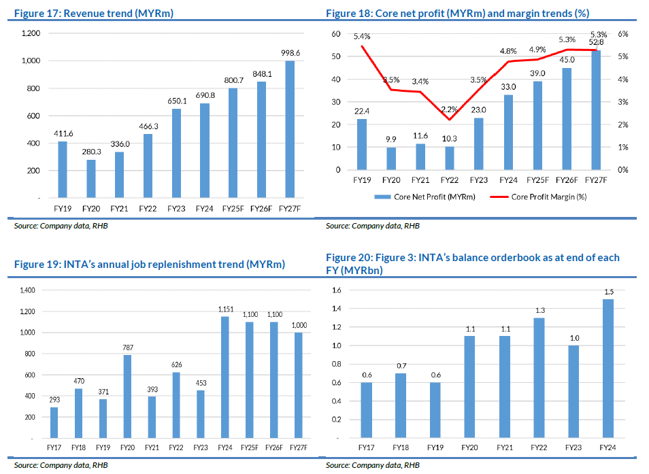
Key Takeaway
Financial Performance & Position
Record Revenue & Profits: Based on the FY2024 result, majority of the revenue comes from residential projects, which account for 83.2% of the total, while non-residential projects contribute 9.4%. The remaining 7.4% is generated from other activities, including property-related services such as lift installation and maintenance.
The company reported an all-time high revenue of RM690.8 million in 2024. Profit before tax (PBT) also reached a record high of RM43.5 million since its listing.
Order Book Strength: As of mid-September 2025, the unbilled order book stood at RM1.8 billion, providing earnings visibility for the next 2 to 2.5 years
Tender Pipeline: The company has a robust outstanding tender book of RM4.5 billion, with a historical success rate of 15% to 20%.

Slide 27
Key Takeaway
Financial Performance & Position
RM’Mil
Quarterly Revenue & PAT
RM’Mil
Total Equity & Market Cap
Annual Revenue & PAT
RM’Mil

Slide 28
Key Takeaway
Financial Performance & Position
The majority of the revenue comes from high rise projects, which account for 74% of the total for FY2024, while low rise projects contribute 19%. The remaining 7.4% is generated from other activities, including property-related services such as lift installation and maintenance. Revenue is progressively skewing toward high-rise developments, as the bulk of current and upcoming work is concentrated in the Klang Valley.
Revenue Breakdown by Construction Segment
RM’Mil | FY2020 | FY2021 | FY2022 | FY2023 | FY2024
High-Rise | 170.2 | 221.8 | 323.3 | 507.9 | 510.4
Low-Rise | 110.1 | 114.2 | 142 | 133 | 129.4
Others* | - | - | 1 | 9.2 | 51
Total | 280.3 | 336.0 | 466.3 | 650.1 | 690.8
*Others include property development, lift installation, and maintenance services
RM’Mil | FY2020 | FY2021 | FY2022 | FY2023 | FY2024
OSK Construction | 197.5 | 101.5 | 132.8 | 215.1 | 323.0

Slide 29
Key Takeaway
Financial Performance & Position
Borrowing increase in FY2024 and 2025 because of (i) higher working capital requirement to execute projects and (ii) acquisition of Aliran Restu ^{N1}
^{N1}100% stake in Aliran Restu Sdn Bhd, which holds development rights to three parcels of land in Bandar Glenmarie, for RM5 million.
Note : Gearing levels to improve as they complete their first major development project, Senori Residence, which is currently 100% sold out for open market units

Slide 30
Key Takeaway
Inta Growth Strategies
Effective execution of unbilled order book through efficient project management
Continuing to pursue construction projects, particularly in affordable housing to replenish and expand our order book
To secure Design and Build contract via creating value to our client
To further source for land for future development and to crease in-house job
To expand facility management project such as Lifts and Escalator maintenance services to build recurring income
To continue expanding new businesses which provide synergistic benefits
The management will remain focused on the private residential sector, particularly affordable housing, and does not currently plan to bid for large government infrastructure projects like the MRT
Strategic Business Diversification
Property Development Expansion: Inta Bina is diversifying from its core construction business into property development to capture higher margins. They aim for development to contribute 30% of revenue within the next five years.
Niche Specialist Works (IBH): Their 55%-owned subsidiary, IBH, specializes in the supply, installation, and maintenance of lifts (Canny Lift brand). Management revealed plans to list this subsidiary in the near future.
Design & Build Model: The company is increasingly securing "Design & Build" contracts, which allow them to optimize costs through value engineering and better buildability.
One
Development
Project
Six
Construction
Projects
Operational Excellence & Quality
Award-Winning Standards: Inta Bina achieved :
Safety : Shassic score of 99.17% for Sunway Artessa (Highest in Malaysia’s record.
Quality : QLASSIC score of 85% for highrise in Tropicana and 90% for Sunway Lenang
Shareholder Returns
Dividend Consistency: Dividend yields ranging from 2.7% to 5.8%.

Slide 31
Key Takeaway
Leadership and Management Team
No. | Name | Age | Position | Key Qualifications | Background & Expertise
1 | Dr. Lim Pang Kiam (Paul) | 62 | Independent Non-Executive Chairman | PhD Business Admin, Fellow CIMA, MIA, CFP | Banking & Corporate Governance. Former Head of Corporate Banking for major banks. Holds multiple chairmanships (Engtex, SDS Group).
2 | Lim Ooi Joo (Paul) | 72 | MD & Executive Director | B.Sc. Civil Engineering (Canada) | Construction Operations. 40+ years experience. Founded Inta Bina; former PWD engineer.
3 | Teo Hock Choon | 67 | Deputy MD & Executive Director | Dip. Tech (Building) | Project Coordination. Veteran in construction; with Inta Bina since 1995.
4 | Ahmad Bin Awi | 55 | Executive Director | OHSAS Safety Certification | Safety & Field Operations. Rose from Tower Crane Operator to Director; safety specialist.
5 | Chau Yik Mun | 52 | Executive Director | B.Eng (Civil) | Civil Engineering. Career growth from Site Supervisor to Project Director over 25 years.
6 | Yap Yoon Kong | 68 | Senior Independent Non-Exec Director | B.Acc (UM), MBA (UK), MIA | Finance & Banking. Former Finance Director of PJ Development Holdings; banking veteran.
7 | Dato' Leanne Koh Li Ann | 52 | Independent Non-Executive Director | B.Com & LLB (Australia) | Tax & Legal. Former Tax Partner at KPMG; specialist in M&A, corporate tax, and restructuring.
8 | Au Foong Yee | 68 | Independent Non-Executive Director | Editor Emeritus (The Edge) | Real Estate & Media. Former MD of The Edge Property; property market expert and industry judge.
No. | Name | Age | Position
1 | Ong Tiau Siang | 47 | General Manager
2 | Sim Yin Joon | 51 | General Manager, Special Project
3 | Lee Yih | 49 | General Manager, Contract
4 | Chin Shiau Yin | 42 | Financial Controller
5 | Foong Jyi Chyuan | 43 | Deputy General Manager, Contract
6 | Ling Tong Hook | 62 | General Manager, Project
7 | Lau Kwai Ban | 43 | Deputy General Manager, Project
8 | Kua Ka Cun | 40 | Senior Purchasing Manager
9 | Norazharudin Bin Omar | 41 | Deputy General Manager, Project
10 | Cheng Lay Ngo | 50 | Human Resource Manager
11 | Lee Kam Weng | 44 | Assistant Finance Manager
Source: AR2024

Slide 32
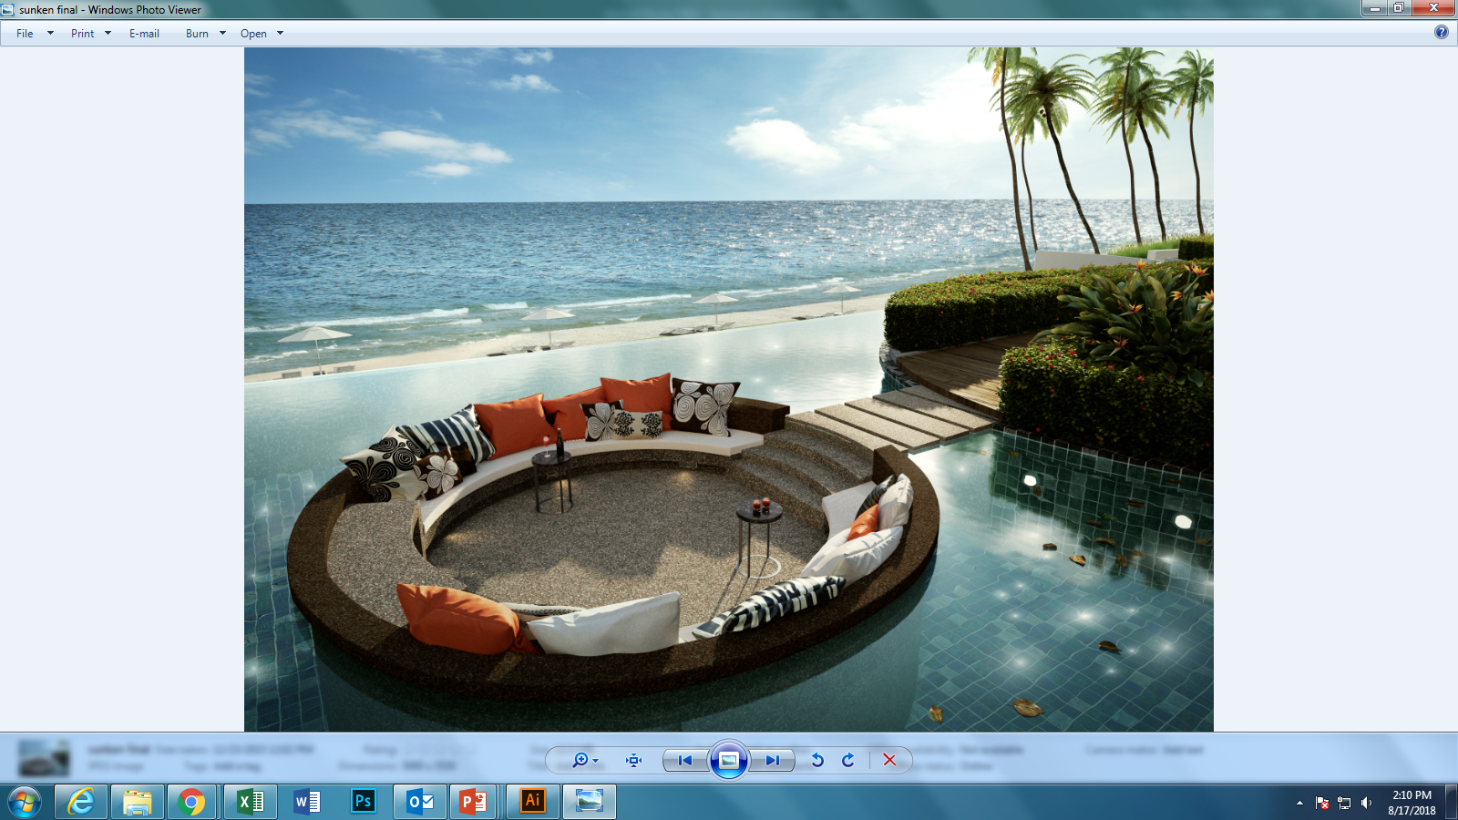
Key Takeaway
Key Risks
Subject to regulatory requirements. As a registered G7 contractor, INTA’s operations are subject to various laws and regulations, including construction licensing, safety, environmental, and industrial compliance. Non-adherence to regulatory standards may result in penalties, suspension of licenses, or disqualification from future tenders, impacting operational continuity and financial performance.
Dependent on Executive Directors and key senior management. The group relies significantly on the experience and leadership of its Executive Directors and senior management team. Loss of any key personnel without timely and effective succession planning could disrupt project execution and strategic direction, adversely affecting business stability.
Dependent on ability to replenish orderbook. INTA’s profitability depends on its ability to clinch new contracts and therefore, any delay in launches of its clients may potentially lead to a sluggish job replenishment trend.
Escalation of construction costs and material prices. The group is also exposed to fluctuations in raw material prices. The key raw materials used include cement and steel, and manufacturers of such raw materials may pass on the cost to customers such as INTA.
Reliance on foreign workers. As INTA depends on foreign labour to execute its jobs, any sudden shortages may pose a risk in the form of delays and cost overrun. This would dampen the group’s profitability.

Slide 33
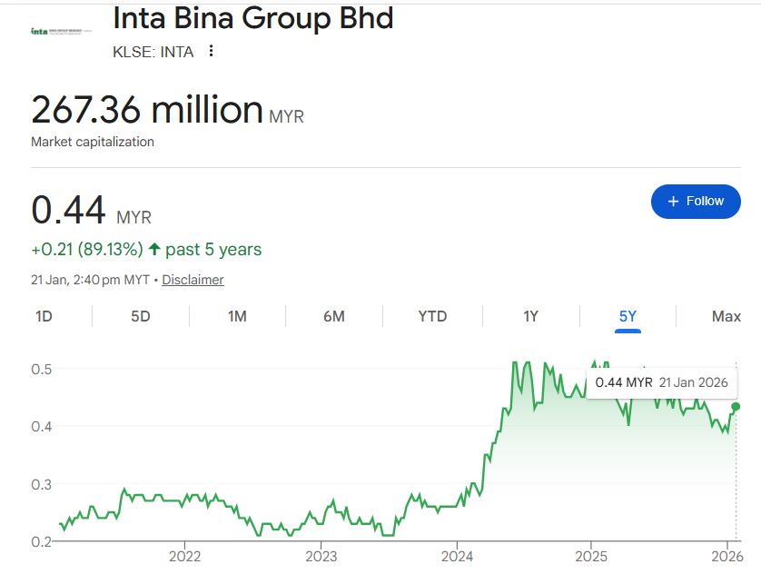
Market Capitalisation & Valuation Metrics
MGB and Kitacon are valued at single-digit P/E multiples broadly in line with Inta, compared to premium valuations for Kerjaya and Binastra, which also have significantly larger market capitalisations.
 | Inta | Kitacon | MGB
52w | 0.345 - 0.520 | 0.665 - 0.795 | 0.405 - 0.740
P/E | 6.91 | 6.87 | 5.03
P/B | 1.09 | 0.99 | 0.41
EV/EBITDA | 4.61 | 1.87 | 2.70
Market Cap (RM’ mil) | 267.4 | 362.7 | 254.4
Shares (mil) | 614.63 | 500.34 | 591.65
 | Binastra | Kerjaya
52w | 1.600 - 2.500 | 1.800 - 2.920
P/E | 20.95 | 16.99
P/B | 7.86 | 2.90
EV/EBITDA | 13.77 | 10.57
Market Cap (RM’ mil) | 2,433.7 | 3,434.5
Shares (mil) | 1,091.35 | 1,267.21
Source :
Klsescreener, Yahoo Finance

Slide 34
Inta Bina Completes Private Placement on 28 May 2025
Company Name | INTA BINA GROUP BERHAD
Date Announced | 28 May 2025
Placement Shares Issued | 55,320,000
Issue Price | RM0.4550
Summary of Utilization of Proceeds
Details of Utilization | Minimum Scenario (RM'000) | Maximum Scenario (RM'000) | Timeframe for Utilization
Capital Expenditure | 12,000 | 12,000 | Within 12 months
Working Capital | 13,079 | 20,177 | Within 24 months
Estimated Expenses | 90 | 90 | Upon completion
Total Gross Proceeds | 25,169 | 32,267
Capital expenditure requirements
Working capital requirements
New Scaffolding & Formwork Systems | 80%
Machinery & Equipment | 20%
Payment to Subcontractors | 40%
Procurement of Raw Materials | 30%
Operational Overheads | 30%
Source : Bursa Announcement

Slide 35
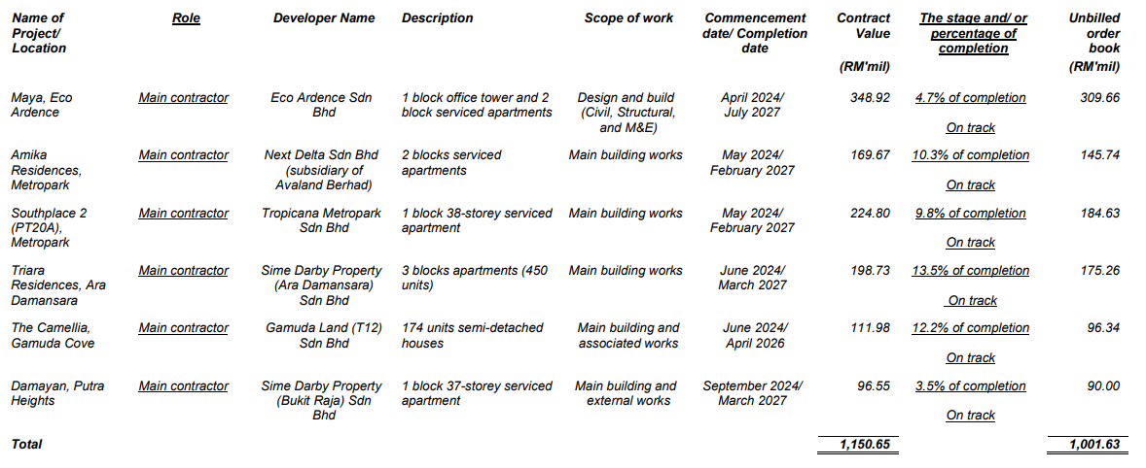
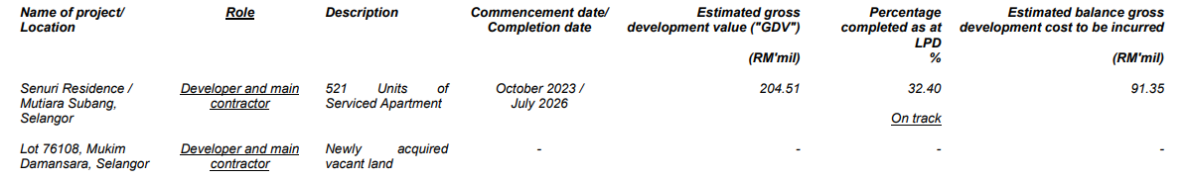
Inta Bina Group Berhad Completes Private Placement
The proceeds earmarked for working capital will be utilised for the construction projects as well as property development projects
Construction projects
Property development projects

Slide 36
Employees Share Option Scheme ("ESOS") – Summary
Inta Bina's ESOS was approved by shareholders at the EGM on 25 June 2021 and implemented on 25 November 2021. The scheme remains in force for 5 years, expiring on 24 November 2026.
List of ESOS Option Offers
Tranche | Date of Offer/Grant | Exercise Price | Number of Options Offered
1st Offer | 12 September 2022 | RM0.21 | 20,760,000
2nd Offer | 12 September 2023 | RM0.24 | 13,380,000
3rd Offer | 26 September 2024 | RM0.45 | 14,010,000
4th Offer | 4 September 2025 | RM0.38 | 16,300,000
Name | 4/9/2025 | 26/9/2024 | 12/9/2023 | 12/9/2022
Dr Lim Pang Kiam | 120,000 | 90,000 | 80,000 | 120,000
Lim Ooi Joo | 900,000 | 800,000 | 800,000 | 1,120,000
Teo Hock Choon | 800,000 | 700,000 | 700,000 | 880,000
Ahmad Bin Awi | 260,000 | 250,000 | 270,000 | 580,000
Chau Yik Mun | 280,000 | 250,000 | 370,000 | 580,000
Yap Yoon Kong | 120,000 | 90,000 | 80,000 | 120,000
Dato’ Leanne Koh Li Ann | 100,000 | 50,000 | 30,000 | 40,000
Au Foong Yee | 100,000 | 50,000 | 30,000 | 40,000
Total | 2,680,000 | 2,280,000 | 2,360,000 | 3,480,000
Source : Bursa, AR2024

Slide 37
Competitor Benchmarking (1 of 2)
New
Inta Bina ranks among the top peers in both revenue and profit.
 | FY2021 | FY2022 | FY2023 | FY2024 |  |  | FY2021 | FY2022 | FY2023 | FY2024 |  |  | FY2021 | FY2022 | FY2023 | FY2024
 | RM'000 | RM'000 | RM'000 | RM'000 |  |  | RM'000 | RM'000 | RM'000 | RM'000 |  |  | RM'000 | RM'000 | RM'000 | RM'000
Revenue |  |  |  |  |  | Gross Profit |  |  |  |  |  | PBT
Tuju Setia | 245,773 | 393,302 | 585,967 | 585,562 |  | Tuju Setia | 17,701 | -23,164 | -1,213 | 11,400 |  | Tuju Setia | 11,144 | -45,895 | -10,150 | 6,045
Crest Builder | 255,412 | 346,085 | 488,335 | 574,569 |  | Crest Builder | 5,064 | 39,658 | 40,714 | 71,491 |  | Crest Builder | -48,828 | -12,895 | -41,138 | 10,828
Pesona Metro | 622,514 | 368,265 | 515,414 | 511,833 |  | Pesona Metro | 36,286 | 32,418 | 53,150 | 68,565 |  | Pesona Metro | -1,907 | -3,552 | 14,358 | 25,228
OSK Construction | 101,524 | 132,790 | 215,137 | 322,990 |  | OSK Construction | 6,348 | 6,827 | 8,393 | 15,008 |  | OSK Construction | 71 | 1,016 | 1,291 | 5,256
Binastra | 38,547 | 184,846 | 425,202 | 946,596 |  | Binastra | 9,458 | 26,154 | 60,576 | 134,138 |  | Binastra | 4,920 | 23,545 | 55,142 | 124,486
Nestcon | 358,261 | 461,518 | 775,146 | 838,132 |  | Nestcon | 28,522 | -407 | 28,314 | 38,841 |  | Nestcon | 12,803 | -18,674 | 5,367 | 9,780
Inta Bina | 335,979 | 466,273 | 650,107 | 690,760 |  | Inta Bina | 31,541 | 31,643 | 52,723 | 68,645 |  | Inta Bina | 17,851 | 13,671 | 31,813 | 43,474
TCS | 204,047 | 261,591 | 374,481 | 392,874 |  | TCS | 19,705 | 10,862 | -17,184 | 13,763 |  | TCS | 7,351 | -2,067 | -31,745 | 1,493
GDB | 424,924 | 510,055 | 319,649 | 258,229 |  | GDB | 47,375 | 29,880 | 13,423 | 55,787 |  | GDB | 37,312 | 21,796 | 10,930 | 40,013
Kitacon | 455,502 | 487,761 | 780,875 | 949,623 |  | Kitacon | 80,862 | 91,349 | 93,952 | 121,116 |  | Kitacon | 52,336 | 53,298 | 48,074 | 70,194
 | FY2021 | FY2022 | FY2023 | FY2024 |  |  | FY2021 | FY2022 | FY2023 | FY2024 |  |  | FY2021 | FY2022 | FY2023 | FY2024
 | RM'000 | RM'000 | RM'000 | RM'000 |  |  | RM'000 | RM'000 | RM'000 | RM'000 |  |  | RM'000 | RM'000 | RM'000 | RM'000
Borrowings |  |  |  |  |  | Equity |  |  |  |  |  | PAT
Tuju Setia | 37,009 | 60,792 | 98,875 | 98,196 |  | Tuju Setia | 106,620 | 71,500 | 62,006 | 73,267 |  | Tuju Setia | 8,277 | -33,535 | -9,494 | 4,363
Crest Builder | 532,082 | 557,027 | 570,662 | 571,977 |  | Crest Builder | 383,027 | 370,722 | 287,645 | 293,284 |  | Crest Builder | -43,555 | -12,305 | -38,977 | 5,639
Pesona Metro | 45,507 | 38,043 | 55,793 | 50,067 |  | Pesona Metro | 171,803 | 168,823 | 181,212 | 201,990 |  | Pesona Metro | -2,090 | -2,980 | 12,389 | 22,311
OSK Construction | - | - | - | - |  | OSK Construction | 22,391 | 22,405 | 17,504 | 20,419 |  | OSK Construction | 56 | 1,014 | 1,099 | 3,916
Binastra | 4,229 | 3,865 | 24,894 | 23,895 |  | Binastra | 1,851 | 42,438 | 83,211 | 282,446 |  | Binastra | -8,665 | 16,523 | 40,773 | 90,255
Nestcon | 64,940 | 149,666 | 201,354 | 203,330 |  | Nestcon | 127,541 | 122,023 | 132,989 | 150,346 |  | Nestcon | 12,211 | -15,560 | 3,901 | 6,467
Inta Bina | 48,745 | 86,774 | 66,471 | 112,651 |  | Inta Bina | 146,932 | 152,322 | 169,547 | 193,567 |  | Inta Bina | 11,688 | 9,558 | 22,886 | 33,137
TCS | 10,899 | 33,557 | 37,395 | 24,231 |  | TCS | 86,222 | 83,301 | 57,650 | 80,327 |  | TCS | 2,473 | -3,397 | -32,885 | 1,484
GDB | - | - | - | - |  | GDB | 151,242 | 160,919 | 169,253 | 195,986 |  | GDB | 28,622 | 17,198 | 8,033 | 26,755
Kitacon | - | - | - | - |  | Kitacon | 184,401 | 214,707 | 297,050 | 334,827 |  | Kitacon | 41,833 | 40,306 | 36,369 | 52,777

Slide 38
Competitor Benchmarking (2 of 2)
New
Inta Bina exceeds peer averages in margin, gearing strength, and revenue-to-staff‑cost efficiency.
 | FY2021 | FY2022 | FY2023 | FY2024 |  |  | FY2021 | FY2022 | FY2023 | FY2024 |  |  | FY2021 | FY2022 | FY2023 | FY2024
 | % | % | % | % |  |  | % | % | % | % |  |  | % | % | % | %
GP Margin |  |  |  |  |  | Gearing |  |  |  |  |  | Debtors T/O (Days)
Tuju Setia | 7.20% | -5.89% | -0.21% | 1.95% |  | Tuju Setia | 0.35 | 0.85 | 1.59 | 1.34 |  | Tuju Setia | 135.97 | 98.10 | 107.56 | 106.75
Crest Builder | 1.98% | 11.46% | 8.34% | 12.44% |  | Crest Builder | 1.39 | 1.50 | 1.98 | 1.95 |  | Crest Builder | 244.56 | 209.87 | 128.58 | 119.64
Pesona Metro | 5.83% | 8.80% | 10.31% | 13.40% |  | Pesona Metro | 0.26 | 0.23 | 0.31 | 0.25 |  | Pesona Metro | 174.55 | 199.31 | 223.44 | 164.23
OSK Construction | 6.25% | 5.14% | 3.90% | 4.65% |  | OSK Construction | - | - | - | - |  | OSK Construction | N/A | N/A | 63.46 | 57.82
Binastra | 24.54% | 14.15% | 14.25% | 14.17% |  | Binastra | 2.28 | 0.09 | 0.30 | 0.08 |  | Binastra | 206.07 | 221.03 | 195.11 | 175.41
Nestcon | 7.96% | -0.09% | 3.65% | 4.63% |  | Nestcon | 0.51 | 1.23 | 1.51 | 1.35 |  | Nestcon | 127.97 | 153.44 | 127.55 | 124.23
Inta Bina | 9.39% | 6.79% | 8.11% | 9.94% |  | Inta Bina | 0.33 | 0.57 | 0.39 | 0.58 |  | Inta Bina | 192.12 | 165.43 | 144.56 | 155.11
TCS | 9.66% | 4.15% | -4.59% | 3.50% |  | TCS | 0.13 | 0.40 | 0.65 | 0.30 |  | TCS | 154.42 | 179.17 | 123.40 | 120.73
GDB | 11.15% | 5.86% | 4.20% | 21.60% |  | GDB | - | - | - | - |  | GDB | 69.48 | 131.83 | 173.27 | 216.90
Kitacon | 17.75% | 18.73% | 12.03% | 12.75% |  | Kitacon | - | - | - | - |  | Kitacon | 84.00 | 84.59 | 77.76 | 73.49
Average Total | 10.17% | 6.91% | 6.00% | 9.90% |  | Average Total | 0.75 | 0.70 | 0.96 | 0.84 |  | Average Total | 154.35 | 160.31 | 136.47 | 131.43
 | FY2021 | FY2022 | FY2023 | FY2024 |  |  | FY2021 | FY2022 | FY2023 | FY2024 |  |  | FY2021 | FY2022 | FY2023 | FY2024
 | % | % | % | % |  |  | % | % | % | % |  |  | % | % | % | %
PBT Margin |  |  |  |  |  | PAT Margin |  |  |  |  |  | Rev/ Staff Cost
Tuju Setia | 4.53% | -11.67% | -1.73% | 1.03% |  | Tuju Setia | 3.37% | -8.53% | -1.62% | 0.75% |  | Tuju Setia | 17.34 | 22.08 | 24.44 | 19.73
Crest Builder | -19.12% | -3.73% | -8.42% | 1.88% |  | Crest Builder | -17.05% | -3.56% | -7.98% | 0.98% |  | Crest Builder | 18.20 | 24.93 | 18.18 | 18.50
Pesona Metro | -0.31% | -0.96% | 2.79% | 4.93% |  | Pesona Metro | -0.34% | -0.81% | 2.40% | 4.36% |  | Pesona Metro | 16.36 | 9.81 | 12.00 | 10.94
OSK Construction | 0.07% | 0.76% | 0.60% | 1.63% |  | OSK Construction | 0.06% | 0.76% | 0.51% | 1.21% |  | OSK Construction | N/A | N/A | 18.27 | 19.77
Binastra | 12.76% | 12.74% | 12.97% | 13.15% |  | Binastra | -22.48% | 8.94% | 9.59% | 9.53% |  | Binastra | 15.42 | 35.62 | 41.20 | 51.08
Nestcon | 3.57% | -4.05% | 0.69% | 1.17% |  | Nestcon | 3.41% | -3.37% | 0.50% | 0.77% |  | Nestcon | 16.69 | 16.55 | 17.07 | 16.27
Inta Bina | 5.31% | 2.93% | 4.89% | 6.29% |  | Inta Bina | 3.48% | 2.05% | 3.52% | 4.80% |  | Inta Bina | 16.25 | 19.15 | 23.95 | 23.17
TCS | 3.60% | -0.79% | -8.48% | 0.38% |  | TCS | 1.21% | -1.30% | -8.78% | 0.38% |  | TCS | 14.23 | 18.02 | 28.85 | 32.60
GDB | 8.78% | 4.27% | 3.42% | 15.50% |  | GDB | 6.74% | 3.37% | 2.51% | 10.36% |  | GDB | 16.56 | 19.92 | 15.20 | 14.23
Kitacon | 11.49% | 10.93% | 6.16% | 7.39% |  | Kitacon | 9.18% | 8.26% | 4.66% | 5.56% |  | Kitacon | 15.53 | 15.38 | 22.00 | 24.09
Average Total | 3.07% | 1.04% | 1.29% | 5.34% |  | Average Total | -1.24% | 0.58% | 0.53% | 3.87% |  | Average Total | 16.29 | 20.16 | 22.12 | 23.04

Slide 39
New
Financial Analysis
The recent private placement has strengthened Inta Bina’s balance sheet, supporting healthy cash (peaking at RM140.6 mil), lower gearing below 1x and a healthy P/B of 1.1–1.4x, reflecting strong liquidity, manageable leverage and fair valuation.
Key Balance Sheet Metrics
Gearing:
0.40
Gearing:
0.33
Gearing:
0.59
Gearing:
0.58
Gearing:
0.77
Gearing:
0.73
Gearing:
0.59
RM’mil
Gearing in Q3 decreased due to proceeds from the private placement being used to repay borrowings
RM’Mil | 1Q24 | 2Q24 | 3Q24 | 4Q24 | 1Q25 | 2Q25 | 3Q25
Cash and short-term deposits | 103.7 | 82.9 | 90.1 | 115.0 | 117.6 | 140.6 | 129.7
Net Debt | (34.6) | (22.2) | 21.9 | (2.3) | 39.3 | 34.5 | 15.7
Total Equity | 174.2 | 184.6 | 190.0 | 193.6 | 203.9 | 240.3 | 246.6
Market Cap | 236.7 | 247.7 | 259.4 | 268.3 | 276.8 | 274.6 | 242.8
Gearing | 0.4 | 0.3 | 0.6 | 0.6 | 0.8 | 0.7 | 0.6
P/B | 1.4 | 1.3 | 1.4 | 1.4 | 1.4 | 1.1 | 1.0

Slide 40
New
Financial Analysis
The company’s fixed assets are heavily weighted towards plant and machinery, which comprise 72% of the PPE balance. Buildings account for 11%, while freehold land and motor vehicles each represent 6%, supporting both operational facilities and site logistics. Office equipment and renovations contribute 2% each, and furniture and fittings make up a minimal 0.1%, indicating that the bulk of the capex is focused on core production and project execution assets rather than administrative or non-operational assets.
RM’mil
Breakdown of PPE as of FY2024
RM’Mil | 1Q24 | 2Q24 | 3Q24 | 4Q24 | 1Q25 | 2Q25 | 3Q25
PPE | 31.89 | 32.57 | 35.75 | 41.46 | 51.62 | 51.21 | 53.77
Land held for Property Development | - | - | - | - | - | 24 | 24
% of (PPE + Land) / Total Assets | 6.7% | 6.8% | 7.1% | 6.7% | 8.2% | 10.9% | 11.5%
Total Assets | 474.39 | 481.28 | 506.78 | 621.58 | 628.68 | 687.22 | 677.51
Plant and Machineries | 72%
Buildings | 11%
Freehold Land | 6%
Motor Vehicles | 6%
Office Equipment | 2%
Office Renovation | 2%
Furniture and Fittings | 0.1%
Total | 100%
*Refer to Appendix for detailed breakdown of PPE

